Slide 1

SAVIOO Hotel and Restaurant
Submitted by: Submitted to:
Asheesh Sharma - G -191500161 Mr. Mandeep singh
Omprakash Sharma - I -191500522 (Technical Trainer)
Somya vashishtha - F – 191500817
Course: B.Tech (CSE)

Slide 2
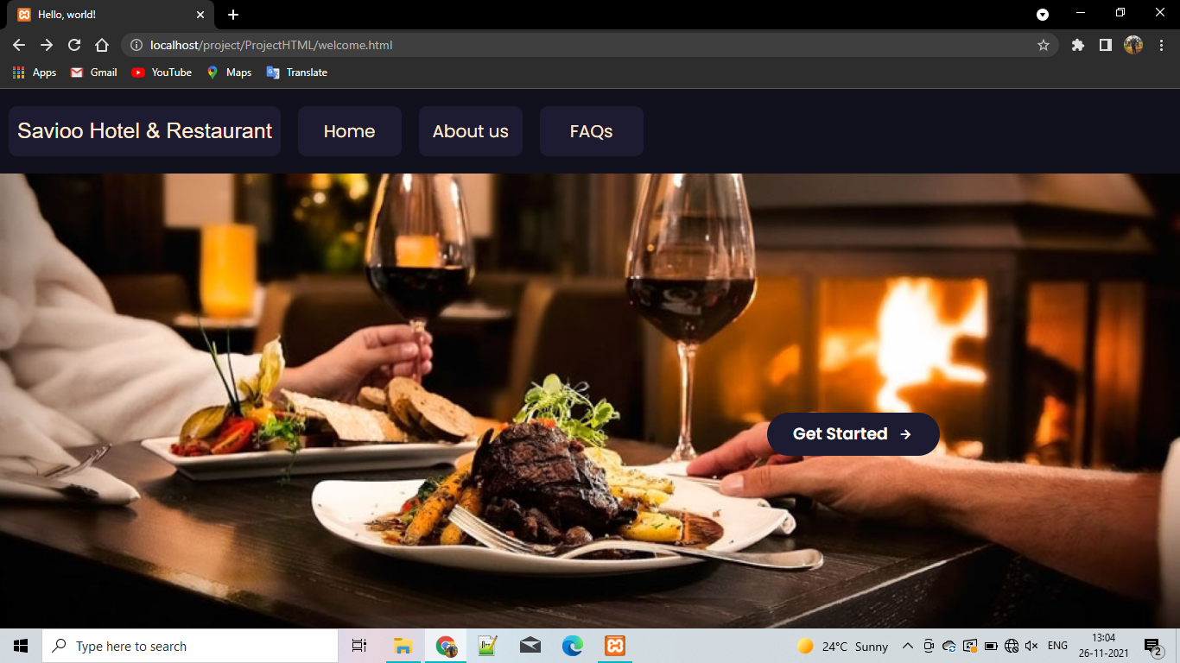

Slide 3
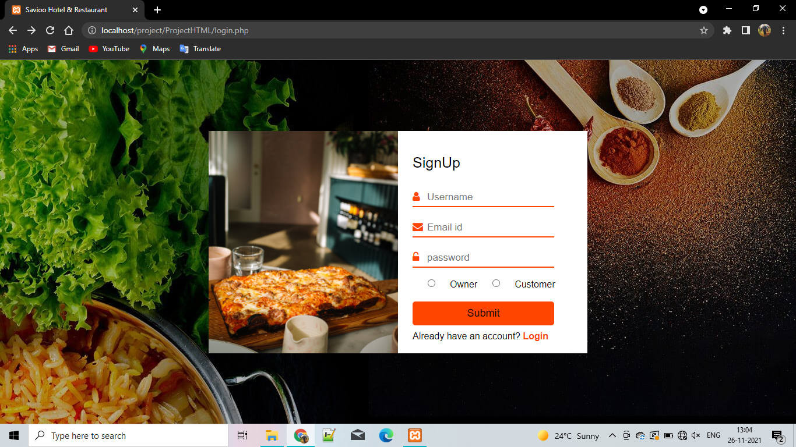

Slide 4
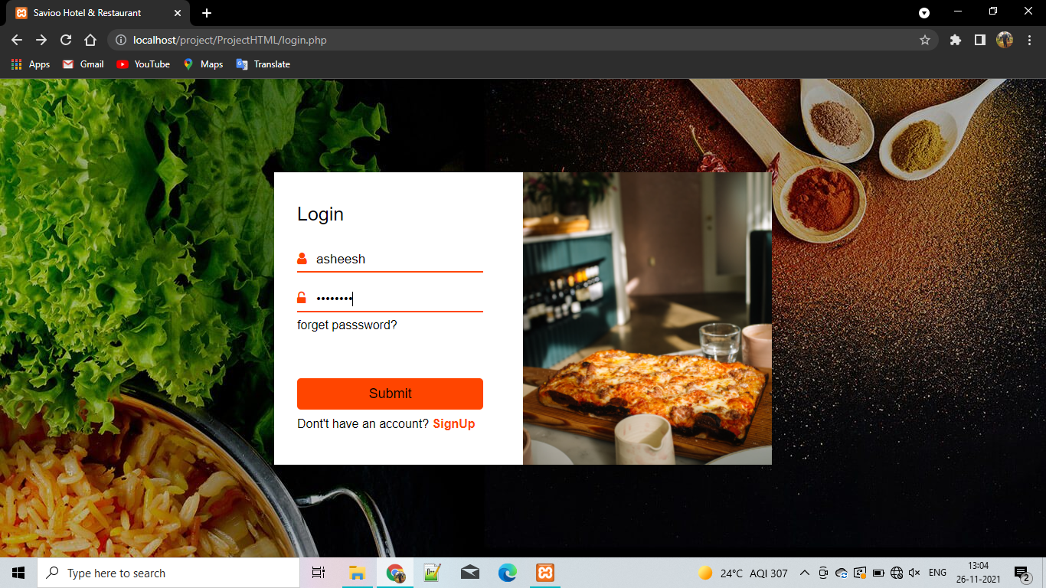

Slide 5
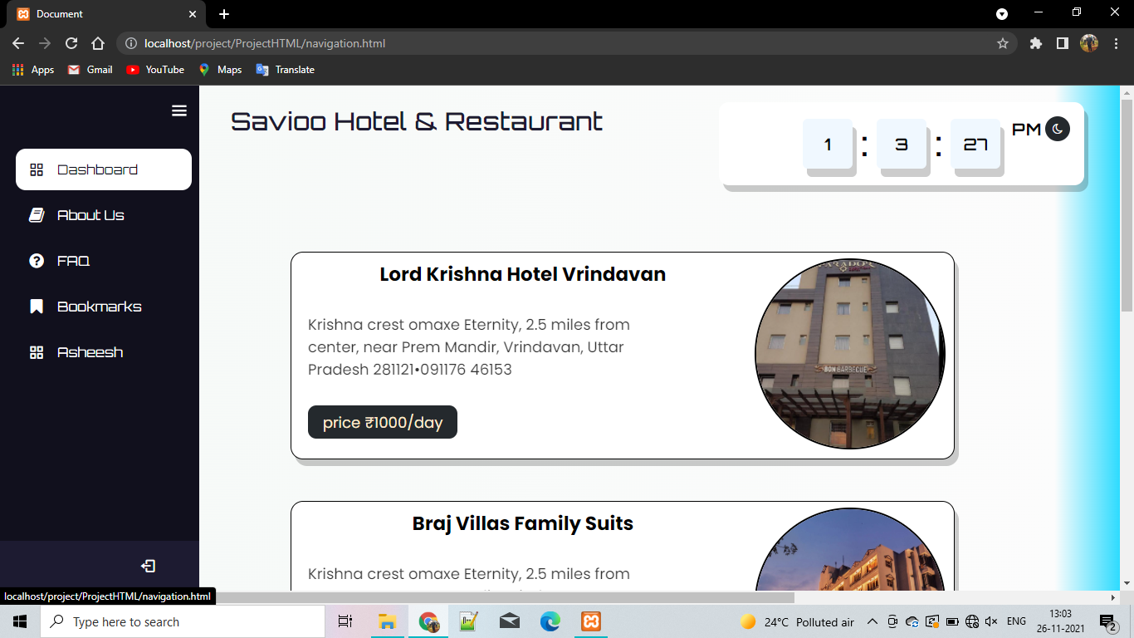

Slide 6
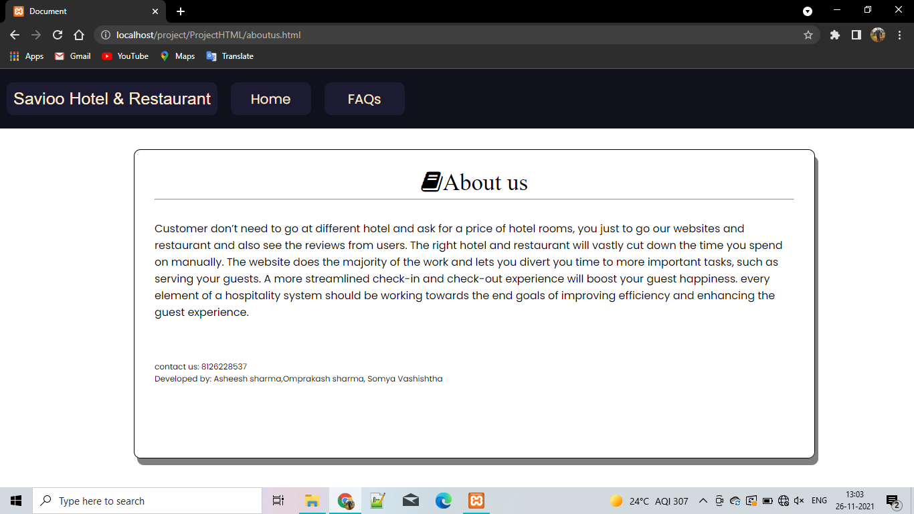

Slide 7
Function and pages
Welcome pages
Login and Signup pages
Navigation
Watch
Shows lists of hotels and restaurant
About us

